Slide 1
Data Science
Session – 12
Date – 08th June, 2022

Slide 2
Statistics - Study Types
A statistical study can be a part of the process of gathering data.
There are different types of studies. Some are better than others, but they might be harder to do.

Slide 3
Main Types of Statistical Studies
The main types of statistical studies are observational and experimental studies.
We are often interested in knowing if something is the cause of another thing.
Experimental studies are generally better than observational studies for investigating this, but usually require more effort.
An observational study is when observe and gather data without changing anything.

Slide 4
Experimental Studies
In an experimental study, the circumstances around the sample is changed. Usually, we compare two groups from a population and these two groups are treated differently.
One example can be a medical study to see if a new medicine is effective.
One group receives the medicine and the other does not. These are the different circumstances around those samples.
We can compare the health of both groups afterwards and see if the results are different.
Experimental studies can allow us to investigate causal relationships. A well designed experimental study can be useful since it can isolate the relationship we are interested in from other effects. Then we can be more confident that we are measuring the true effect.

Slide 5
Statistics - Sample Types
A study needs participants and there are different ways of gathering them.
Some methods are better than others, but they might be more difficult.

Slide 6
Different Types of Sampling Methods
Random Sampling
A random sample is where every member of the population has an equal chance to be chosen.
Random sampling is the best. But, it can be difficult, or impossible, to make sure that it is completely random.
Note: Every other sampling method is compared to how close it is to a random sample - the closer, the better.
Convenience Sampling
A convenience sample is where the participants that are the easiest to reach are chosen.
Note: Convenience sampling is the easiest to do.
In many cases this sample will not be similar enough to the population, and the conclusions can potentially be useless.
Systematic Sampling
A systematic sample is where the participants are chosen by some regular system.
For example:
The first 30 people in a queue
Every third on a list
The first 10 and the last 10

Slide 7
Different Types of Sampling Methods
4. Stratified Sampling
A stratified sample is where the population is split into smaller groups called 'strata'.
The 'strata' can, for example, be based on demographics, like:
Different age groups
Professions
Stratification of a sample is the first step. Another sampling method (like random sampling) is used for the second step of choosing participants from all of the smaller groups (strata).
5. Clustered Sampling
A clustered sample is where the population is split into smaller groups called 'clusters'.
The clusters are usually natural, like different cities in a country.
The clusters are chosen randomly for the sample.
All members of the clusters can participate in the sample, or members can be chosen randomly from the clusters in a third step.

Slide 8
Statistics - Data Types
Data can be different types, and require different types of statistical methods to analyze.

Slide 9
Different types of data
There are two main types of data: Qualitative (or 'categorical') and quantitative (or 'numerical'). These main types also have different sub-types depending on their measurement level.
Qualitative Data
Information about something that can be sorted into different categories that can't be described directly by numbers.
Examples:
Brands
Nationality
Professions
With categorical data we can calculate statistics like proportions. For example, the proportion of Indian people in the world, or the percent of people who prefer one brand to another.
Quantitative Data
Information about something that is described by numbers.
Examples:
Income
Age
Height
With numerical data we can calculate statistics like the average income in a country, or the range of heights of players in a football team.

Slide 10
Statistics - Measurement Levels
Different data types have different measurement levels.
Measurement levels are important for what types of statistics can be calculated and how to best present the data.

Slide 11
Measurement Levels
The main types of data are Qualitative (categories) and Quantitative (numerical). These are further split into the following measurement levels.
These measurement levels are also called measurement 'scales'
Nominal Level
Categories (qualitative data) without any order.
Examples:
Brand names
Countries
Colors
Ordinal level
Categories that can be ordered (from low to high), but the precise "distance" between each is not meaningful.
Examples:
Letter grade scales from F to A
Military ranks
Level of satisfaction with a product

Slide 12
Measurement Levels
2. Ordinal level
Consider letter grades from F to A: Is the grade A precisely twice as good as a B? And, is the grade B also twice as good as C?
Exactly how much distance it is between grades is not clear and precise. If the grades are based on amounts of points on a test, you can say that there is a precise "distance" on the point scale, but not the grades themselves.
3. Interval Level
Data that can be ordered and the distance between them is objectively meaningful. But there is no natural 0-value where the scale originates.
Examples:
Years in a calendar
Temperature measured in Fahrenheit
Note: Interval scales are usually invented by people, like degrees of temperature.
0 degrees Celsius is 32 degrees of Fahrenheit. There is consistent distances between each degree (for every 1 extra degree of Celsius, there is 1.8 extra Fahrenheit), but they do not agree on where 0 degrees is.

Slide 13
Measurement Levels
4. Ratio Level
Data that can be ordered and there is a consistent and meaningful distance between them. And it also has a natural 0-value.
Examples:
Money
Age
Time
Data that is on the ratio level (or "ratio scale") gives us the most detailed information. Crucially, we can compare precisely how big one value is compared to another. This would be the ratio between these values, like twice as big, or ten times as small.

Slide 14
Statistics - Descriptive Statistics
Descriptive statistics gives us insight into data without having to look at all of it in detail.

Slide 15
Key Features to Describe about Data
Getting a quick overview of how the data is distributed is a important step in statistical methods.
We calculate key numerical values about the data that tells us about the distribution of the data. We also draw graphs showing visually how the data is distributed.
Key Features of Data:
Where is the center of the data? (location)
How much does the data vary? (scale)
What is the shape of the data? (shape)
These can be described by summary statistics (numerical values).

Slide 16
Key Features to Describe about Data Contd.
The Center of the Data
The center of the data is where most of the values are concentrated.
Different kinds of averages, like mean, median and mode, are measures of the center.
Note: Measures of the center are also called location parameters, because they tell us something about where data is 'located' on a number line.
The Variation of the Data
The variation of the data is how spread out the data are around the center.
Statistics like standard deviation, range and quartiles are measures of variation.
Note: Measures of variation are also called scale parameters.
The Shape of the Data
The shape of the data can refer to the how the data are bunched up on either side of the center.
Statistics like skew describe if the right or left side of the center is bigger. Skew is one type of shape parameters.
Frequency Tables
One typical of presenting data is with frequency tables.
A frequency table counts and orders data into a table. Typically, the data will need to be sorted into intervals.
Frequency tables are often the basis for making graphs to visually present the data.

Slide 17
Visualizing Data
Different types of graphs are used for different kinds of data. For example:
Pie charts for qualitative data
Histograms for quantitative data
Scatter plots for bivariate data
Graphs often have a close connection to numerical summary statistics.
For example, box plots show where the quartiles are.
Quartiles also tell us where the minimum and maximum values, range, interquartile range, and median are.

Slide 18
Statistics - Frequency Tables
A frequency table is a way to present data. The data are counted and ordered to summarize larger sets of data.
With a frequency table you can analyze the way the data is distributed across different values.

Slide 19
Frequency Tables
Frequency means the number of times a value appears in the data. A table can quickly show us how many times each value appears.
If the data has many different values, it is easier to use intervals of values to present them in a table.
Here is the age of the 934 Nobel Prize winners up until the year 2020. In the table each row is an age interval of 10 years.
We can see that there is only one winner from ages 10 to 19. And that the highest number of winners are in their 60s.
Note: The intervals for the values are also called 'bins'.
Age Interval | Frequency
10-19 | 1
20-29 | 2
30-39 | 48
40-49 | 158
50-59 | 236
60-69 | 262
70-79 | 174
80-89 | 50
90-99 | 3

Slide 20
Relative Frequency Tables
Relative frequency means the number of times a value appears in the data compared to the total amount. A percentage is a relative frequency.
Here are the relative frequencies of ages of Noble Prize winners. Now, all the frequencies are divided by the total (934) to give percentages.
Age Interval | Relative Frequency
10-19 | 0.11%
20-29 | 0.21%
30-39 | 5.14%
40-49 | 16.92%
50-59 | 25.27%
60-69 | 28.05%
70-79 | 18.63%
80-89 | 5.35%
90-99 | 0.32%

Slide 21
Cumulative Frequency Tables
Cumulative frequency counts up to a particular value.
Here are the cumulative frequencies of ages of Nobel Prize winners. Now, we can see how many winners have been younger than a certain age.
Cumulative frequency tables can also be made with relative frequencies (percentages).
Age | Cumulative Frequency
Younger than 20 | 1
Younger than 30 | 3
Younger than 40 | 51
Younger than 50 | 209
Younger than 60 | 445
Younger than 70 | 707
Younger than 80 | 881
Younger than 90 | 931
Younger than 100 | 934
Age Interval | Frequency
10-19 | 1
20-29 | 2
30-39 | 48
40-49 | 158
50-59 | 236
60-69 | 262
70-79 | 174
80-89 | 50
90-99 | 3

Slide 22
Statistics - Graphs

Slide 23
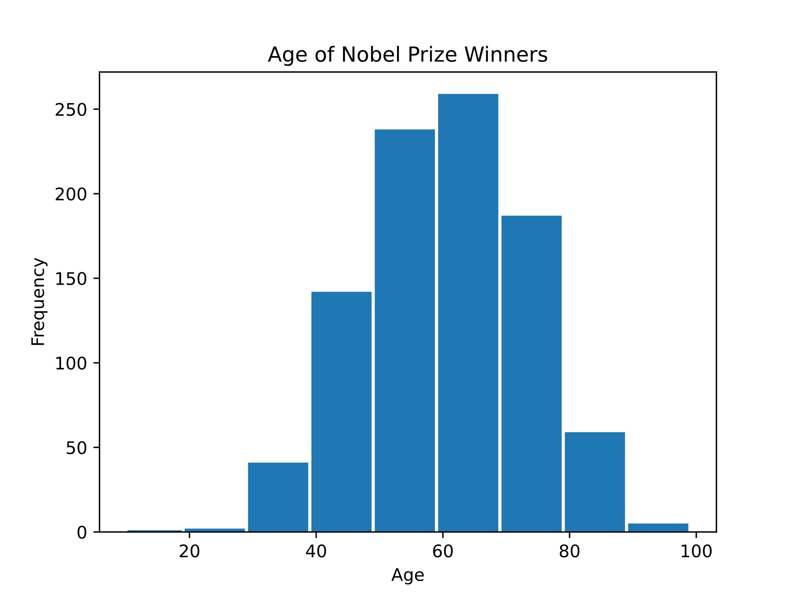
Statistics - Histograms
A histogram visually presents quantitative data.
A histogram is a widely used graph to show the distribution of quantitative (numerical) data.
It shows the frequency of values in the data, usually in intervals of values. Frequency is the amount of times that value appeared in the data.
Each interval is represented with a bar, placed next to the other intervals on a number line.
The height of the bar represents the frequency of values in that interval.
Here is a histogram of the age of all 934 Nobel Prize winners up to the year 2020:
This histogram uses age intervals from 10 to 19, 20 to 29, and so on.
Note: Histograms are similar to bar graphs, which are used for qualitative data.

Slide 24
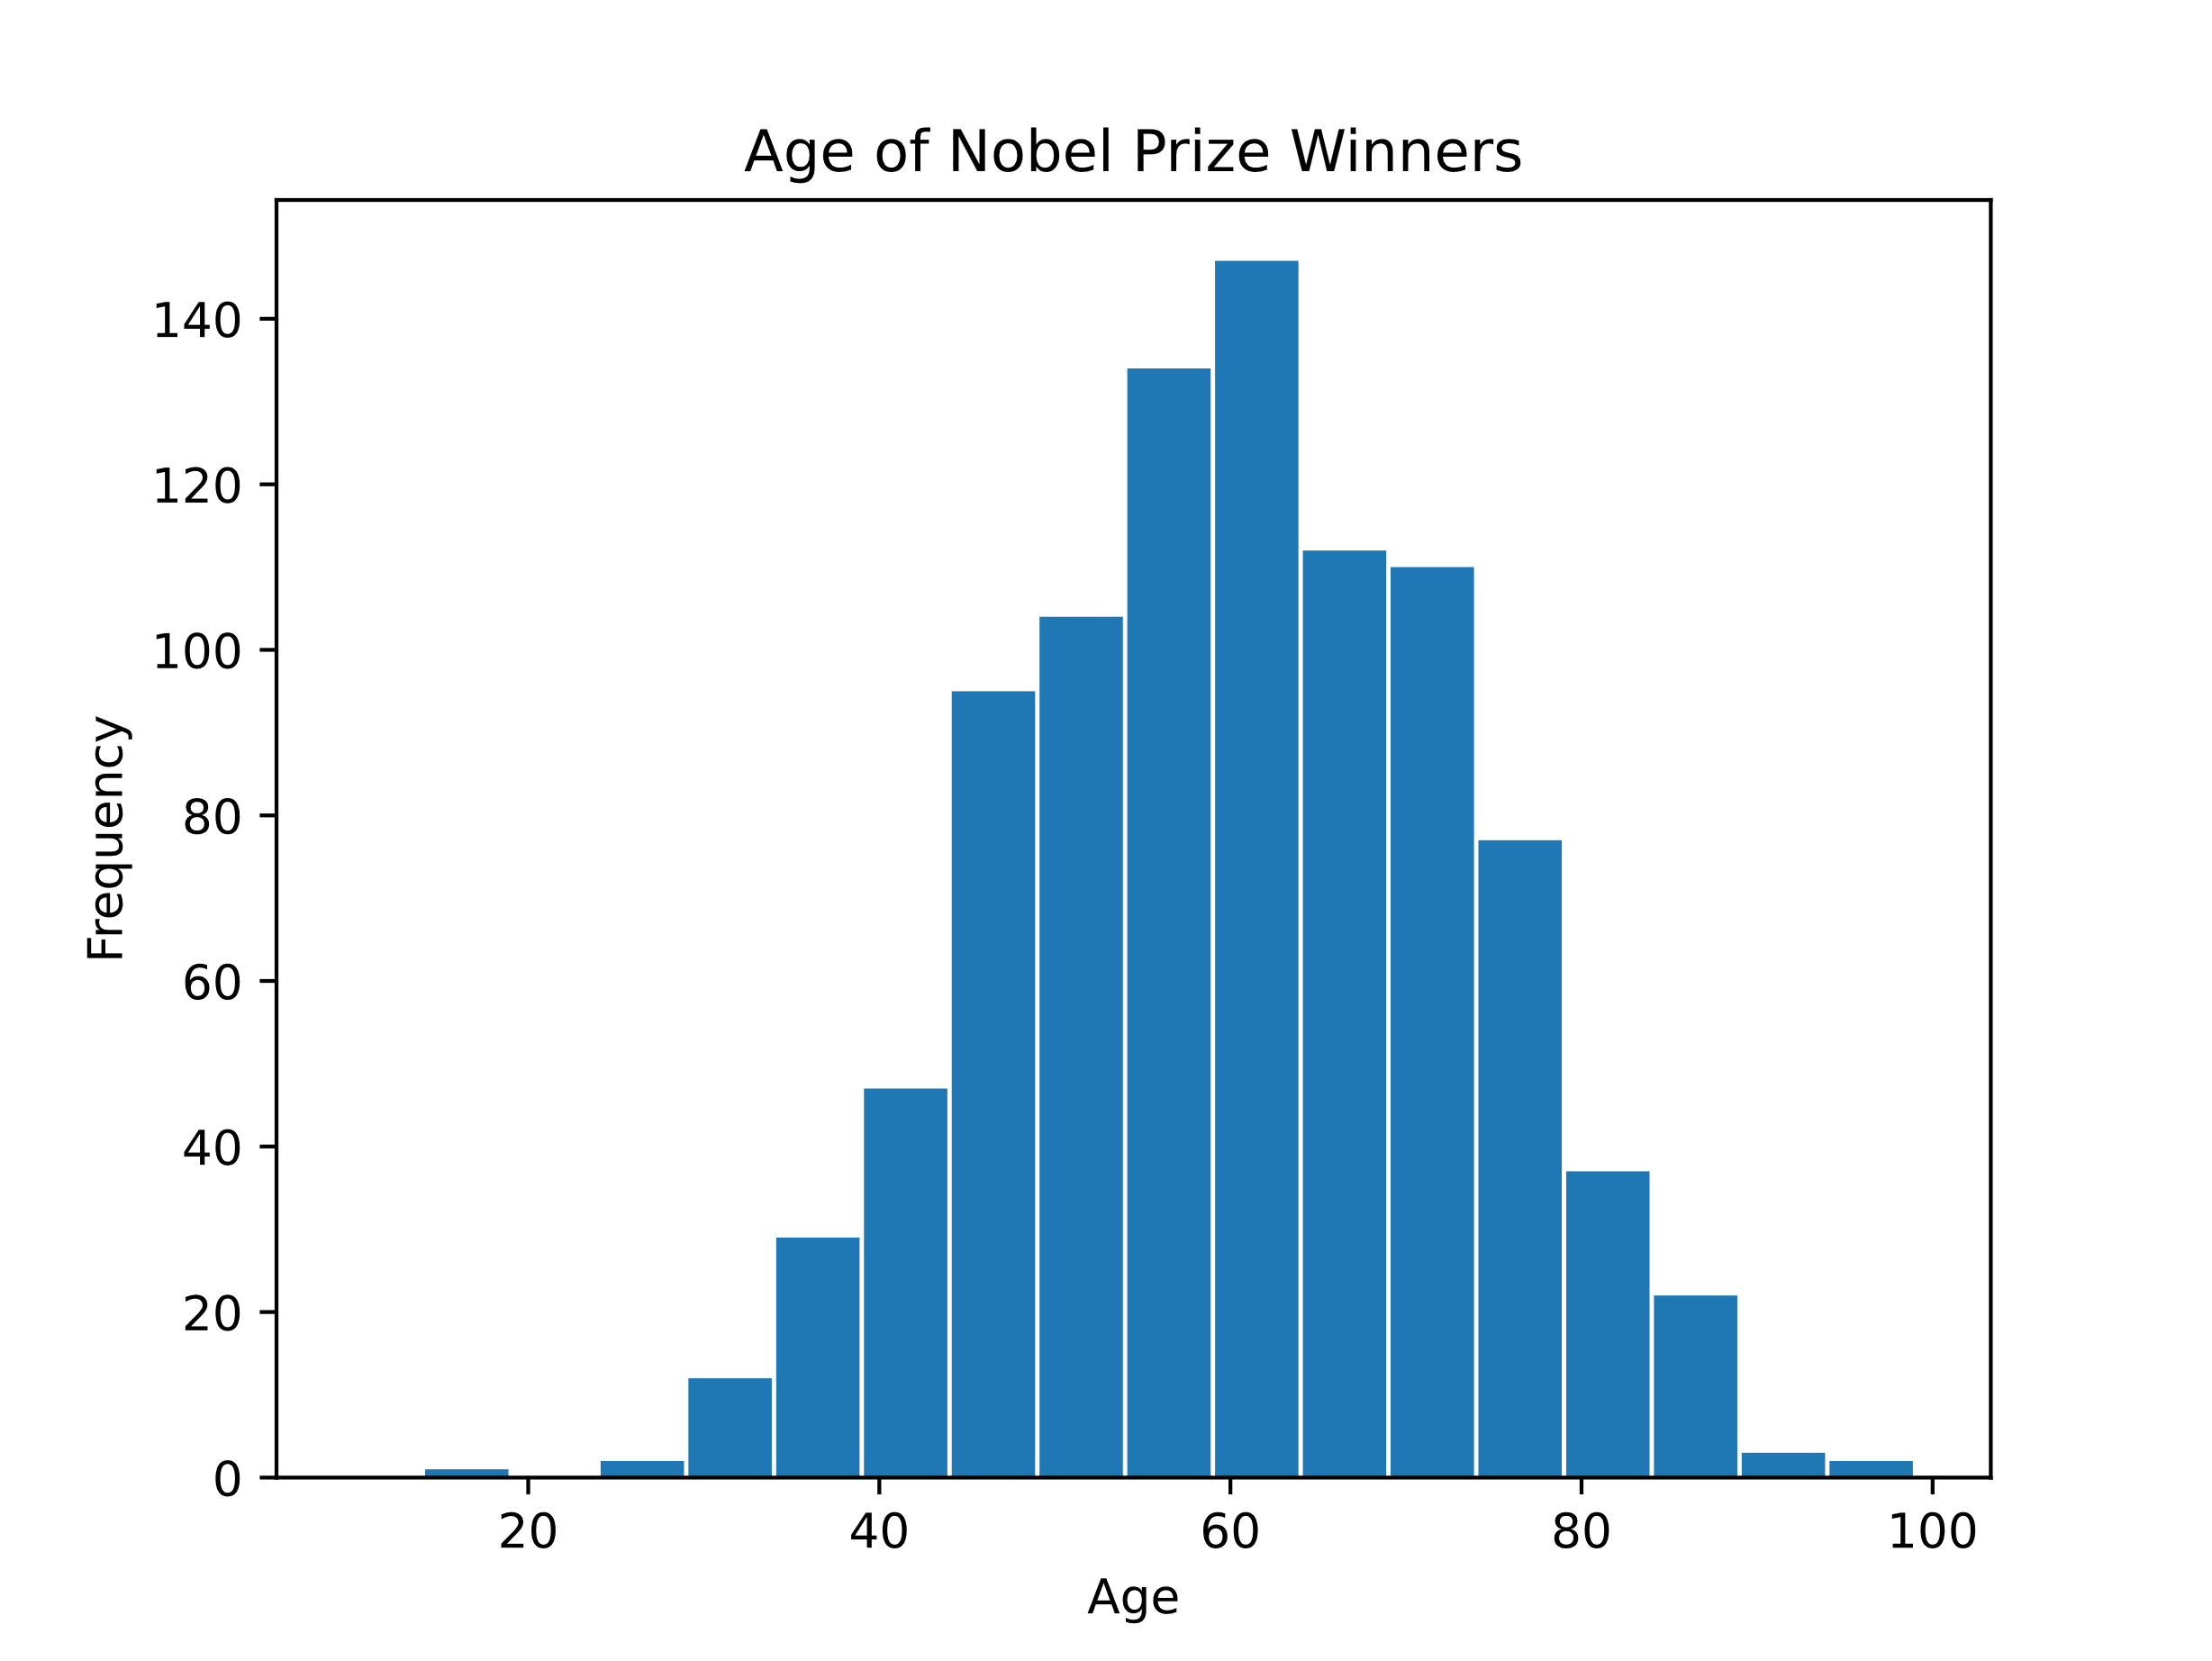
Statistics - Histograms
Bin Width
The intervals of values are often called 'bins'. And the length of an interval is called 'bin width'.
We can choose any width. It is best with a bin width that shows enough detail without being confusing.
Here is a histogram of the same Nobel Prize winner data, but with bin widths of 5 instead of 10:
This histogram uses age intervals from from 15 to 19, 20 to 24, 25 to 29, and so on.
Smaller intervals gives a more detailed look at the distribution of the age values in the data.

Slide 25
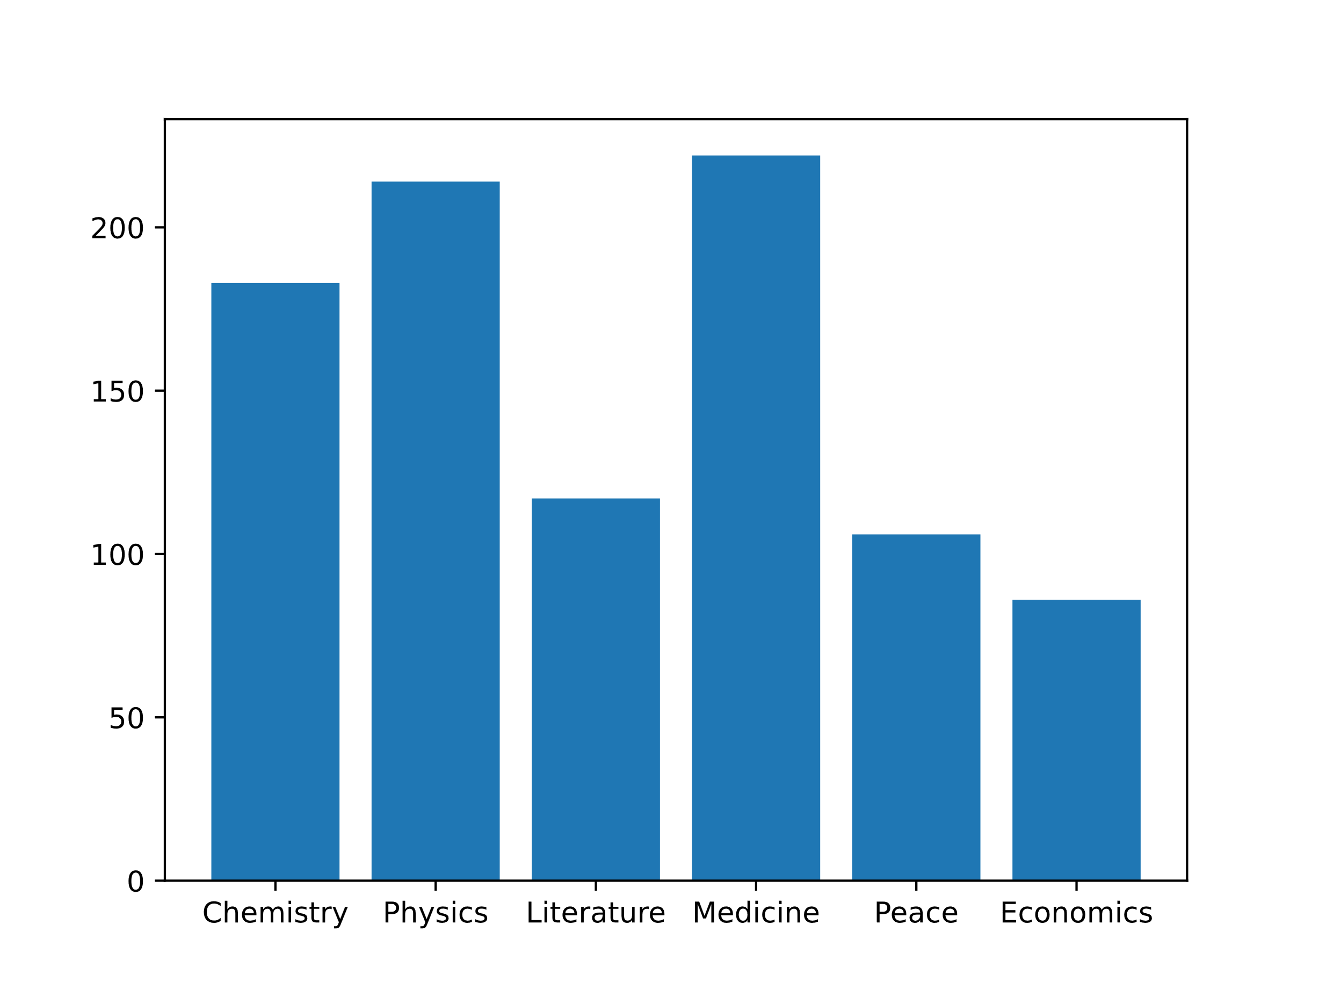
Statistics - Bar Graphs
A bar graph visually presents qualitative data.
Bar graphs are used show the distribution of qualitative (categorical) data.
It shows the frequency of values in the data. Frequency is the amount of times that value appeared in the data.
Each category is represented with a bar. The height of the bar represents the frequency of values from that category in the data.
Here is a bar graph of the number of people who have won a Nobel Prize in each category up to the year 2020:
Some of the categories have existed longer than others. Multiple winners are also more common in some categories. So there is a different number of winners in each category.
Note: Bar graphs are similar to histograms, which are used for quantitative data.

Slide 26
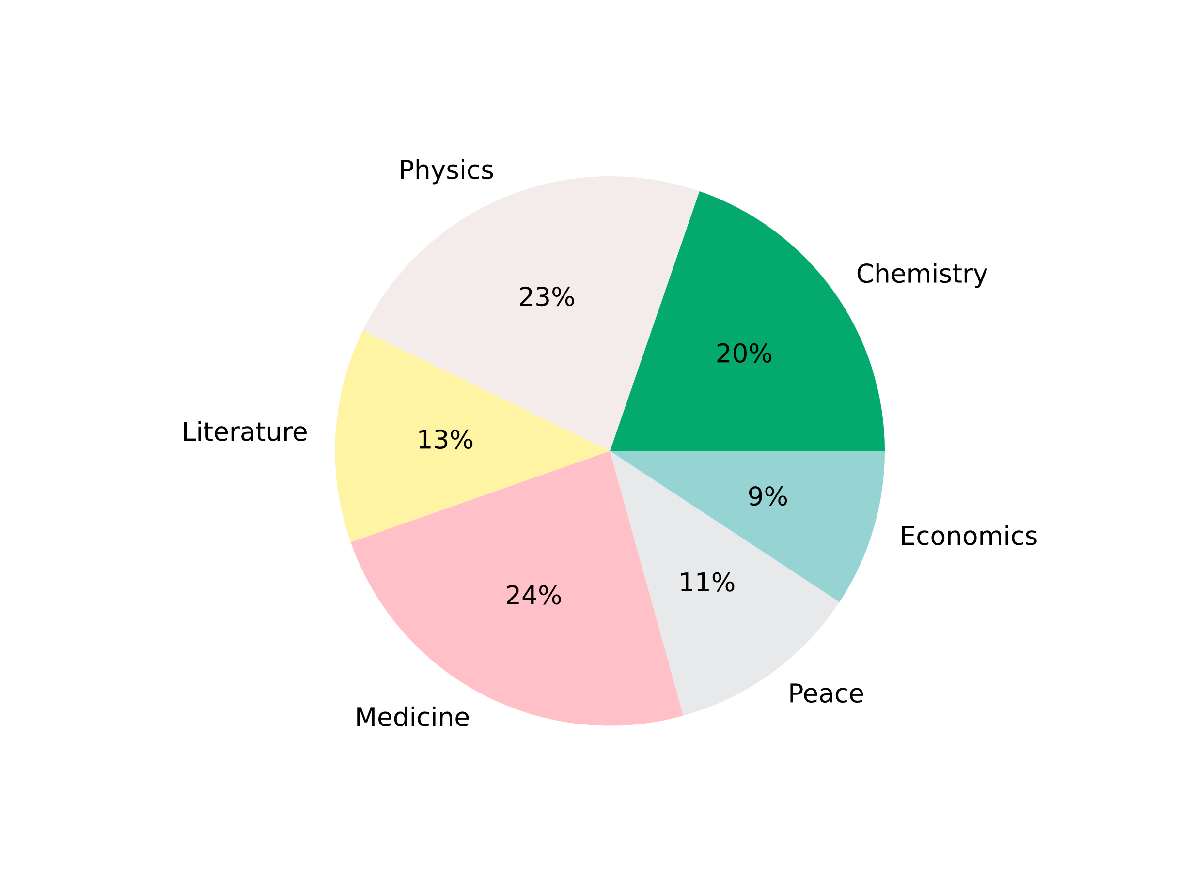
Statistics - Pie Charts
A pie chart visually presents qualitative data.
Pie graphs are used to show the distribution of qualitative (categorical) data.
It shows the frequency or relative frequency of values in the data.
Frequency is the amount of times that value appeared in the data. Relative frequency is the percentage of the total.
Each category is represented with a slice in the 'pie' (circle). The size of each slice represents the frequency of values from that category in the data.
Here is a pie chart of the number of people who have won a Nobel Prize in each category up to the year 2020:
This pie chart shows relative frequency. So each slice is sized by the percentage for each category.
Some of the categories have existed longer than others. Multiple winners are also more common in some categories. So there is a different number of winners in each category.

Slide 27
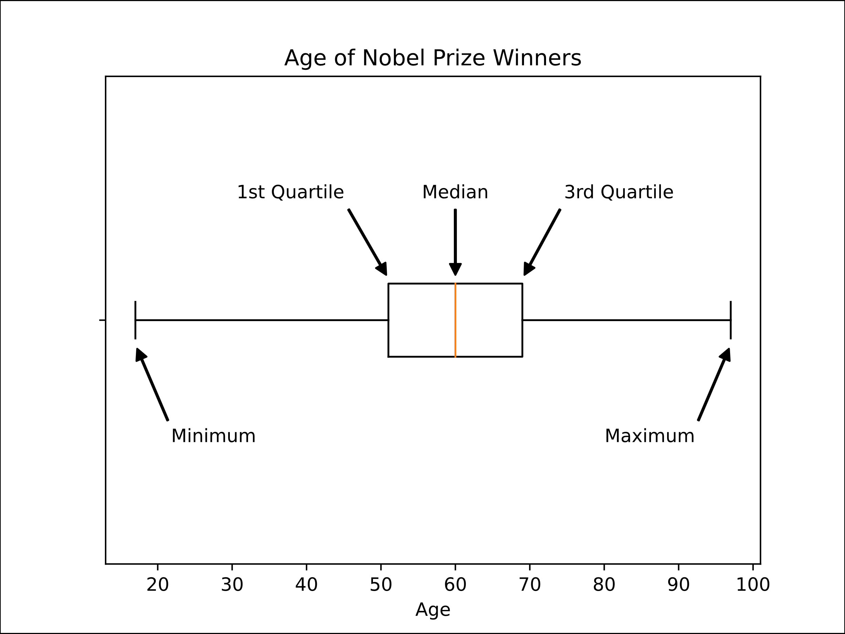
Statistics - Box Plots
A box plot is a graph used to show key features of quantitative data.
A box plot is a good way to show many important features of quantitative (numerical) data.
It shows the median of the data. This is the middle value of the data and one type of an average value.
It also shows the range and the quartiles of the data. This tells us something about how spread out the data is.
Here is a box plot of the age of all the Nobel Prize winners up to the year 2020:

Slide 28
Statistics - Box Plots
The median is the red line through the middle of the 'box'. We can see that this is just above the number 60 on the number line below. So the middle value of age is 60 years.
The left side of the box is the 1st quartile. This is the value that separates the first quarter, or 25% of the data, from the rest. Here, this is 51 years.
The right side of the box is the 3rd quartile. This is the value that separates the first three quarters, or 75% of the data, from the rest. Here, this is 69 years.
The distance between the sides of the box is called the inter-quartile range (IQR). This tells us where the 'middle half' of the values are. Here, half of the winners were between 51 and 69 years.
The ends of the lines from the box at the left and the right are the minimum and maximum values in the data. The distance between these is called the range.
The youngest winner was 17 years old, and the oldest was 97 years old. So the range of the age of winners was 80 years.
Note: Box plots are also called 'box and whiskers plots'.

